Slide 1
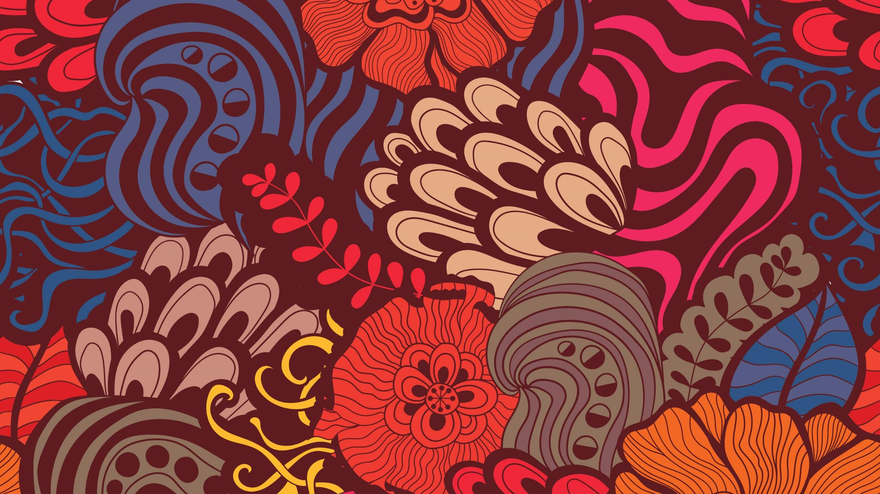
Love Magic
Hannah Norum

Slide 2
Origin and Classification
Fourth century B.C. onward
Two Groups:
Separation
Attraction
Notes:
Love Magic is a form of magic that has been associated with witchcraft for many years. Love magic proof was found on erotic curse tablets, dating back to the fourth century B.C. and on. Love Magic is a very big concept with many parts, when looking at love magic as a whole there are two main groupings for all of these aspects. The groups are Separation Magic and Attraction Magic, these groups represent various ways that love magic is used

Slide 3
Love Magic: Good or Bad?
Positive Aspects:
Arousal of Passion
Gaining love
Achieving a partner that without magic would’ve been unattainable
Negative Aspects:
Preventing someone from finding love
The breaking up of relationships
Used to effect the ability to conceive a child
Notes:
Love Magic could be seen in both positive and negative ways. The positive aspects of love magic are that it can be used to arouse a sexual passion of one person onto another, the person is finding a partner and gaining a love that they are seeking for and they could also use it to achieve a partner that was otherwise unattainable, such as married women. Some negative aspects of love magic are that they are preventing a person from engaging in a sexual relationship with another person, there could be a breaking up of a marriage or loving relationship, and it could be used to prevent a married couple from being able to conceive a child, which was a very significant aspect of a marriage.

Slide 4
Ancient Greek: Love Magic
Clay effigy
Ritual operation types
Similarities and Differences between curses and erotic spells
Agōgē Spell
Notes:
In Ancient Greece there where many rituals and aspects of love magic. When love magic was being preformed an aspect commonly used was a clay effigy, an example of this was discovered in Egypt, it was a clay effigy of a women sealed inside of a pot, with a folded lead tablet that had been inscribed with a magic spell in Greek. In this example a man is using this love magic and is using this effigy to make a women that he desires to lose her proud demeanour and to come and love him, as well as he is using the help of ghosts to ensure that until she comes to him, she will be unable to engage in the joys of life. This example shows the use of on type of ritual operations, there are two types of ritual operations and those are: one requiring the assistance of spiritual powers, the other are ones that do not require this power. When looking at love magic and these erotic spells there are many similarities and difference between these spells and curses. These similarities are that nearly every for of spoken curse used against Greek enemies are also apart of the erotic spell repertoire, as well as both types also use effigies in order to bind enemies and forced them into a subservient position. The Agōgē Spell is the most popular Greek charms used, this is because of the immediateness of it, the spell worked to lead the women out of her husband or fathers house and towards the practitioner.

Slide 5
Roman World: Love Magic
Ancient Hebrew steps for making a woman fall in love with a man
Four types of formulas on defixiones
Amulets
Notes:
In the Roman World there are ancient Hebrew steps to take to cause a woman to fall in love with a man. There are 3 main steps in this process: the first is to take two sheets of tin and write the name of a man on one sheet, and on the other a name of a woman followed by a list of angels, step two is to than say a prayer for recitation. The last step is the most complex, on the 29th day of the month the tin sheets need to be placed into either a furnace or into a bath frequented by the woman. In order for this process to come true the practitioner also must follow some rules, such as obtaining from meat, wine and sexual intercourse. Defixiones, also known as curse tablets, contain one of the four types of formulas. These formulas are either direct binding formulas, prayer formula, wish formula, and similibus formula. Another aspect used in love magic were amulets. Amulets were objects used as a direct mediator between divine forces and specific people or places. They would represent these blessings in this material form and physically connect them with a person.

Slide 6
Interesting Facts
Fish
Nails
Kolossi
Curse Tablets
Notes:
An interesting fact is that fish is used in many types of magic, it is more often used in non-erotic magic, but it can also commonly be used in erotic magic. It is used to adhere to a vessel to represent a conjoining and attachment to their partner. Nails were a very common theme that come up in various forms of love magic. With Kolossi’s nails are used to puncture these dolls while saying a spell in order for the practitioner to gain control over that specific part of the persons body, such as their heart. Nails were also used as a way to seal this magic, for cures tablets they would be folded, fixed closed with many nails, and than deposited near the individual that the spell is for.

Slide 7
Bibliography
“Love Magic In Antiquity.” The Witchcraft Sourcebook. New York, New York: Routledge, 2015.
Faraone, Christopher A. "Spells for Inducing Uncontrollable Passion (Erōs)." Ancient Greek Love Magic. Cambridge, Massachusetts; London, England: Harvard University Press, 1999. 41-59.
Janowitz, Naomi. “Ancient Rites for Gaining Lovers.” Magic in the Roman World : Pagans, Jews and Christians. London: -Taylor & Francis Group, 2001. 47-58.
Ogden, Daniel. “Erotic Magic.” Magic, Witchcraft, and Ghosts in Greek and Roman Worlds: A Sourcebook. New York, New York: Oxford University Press, 2002.
Rampton, Martha. “Curse Tablets and Binding Spells.” European Magic and Witchcraft: A Reader. Ontario: The University of Toronto Press, 2018.
Watson, Lindsay C. “The Echeneis and Erotic Magic.” The Classical Quarterly, New Series, 60, no. 2 (2010): 639- 46.
Notes:
Sources referred to in creating this PowerPoint.

