Slide 1
The Importance of Satan to the Creation of Witches
Mikeila Oliveira

Slide 2
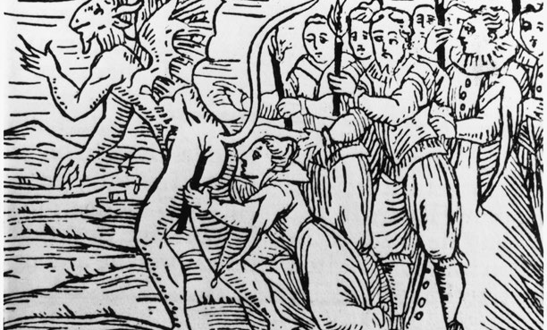
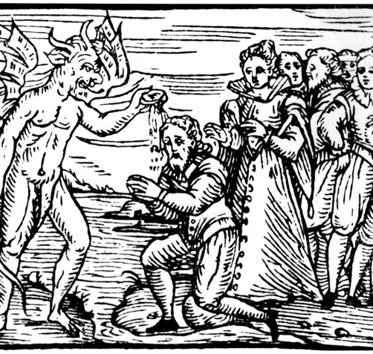
Who/What is the Devil?
A role, not a person
God’s enemy
Creation at the end of the 4th Century
“Satan stood up against Israel” (1 Chronicles 21 KJV).
Composed likely between 350-300 BC

Slide 3
Sorcerer/Sorceress
Magician
Practitioner
Witch

Slide 4
Witches and the Devil
Witch of Endor
1 Samuel 28: 1-25
Old Testament
7th Century BC
King Saul seeking the Witch of Endor to summon Samuel’s ghost
Sinful vs Non-sinful magic
Pagan Magic vs. Christian Miracles
Rise of Christianity
Depiction of the Devil

Slide 5
God pan
5th-7th Century
Pagan gods demonized
Horns
Woven feet
Non-human (partial animal like creature)

Slide 6
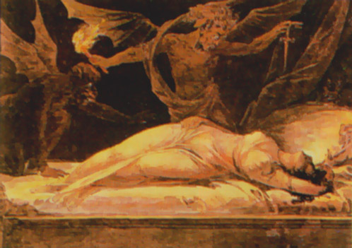
The devil-witch Relationship
Allegiance
Necromancy
Demonic sex
sabbath

Slide 7
Summary:
Thank you for listening!

