Slide 1
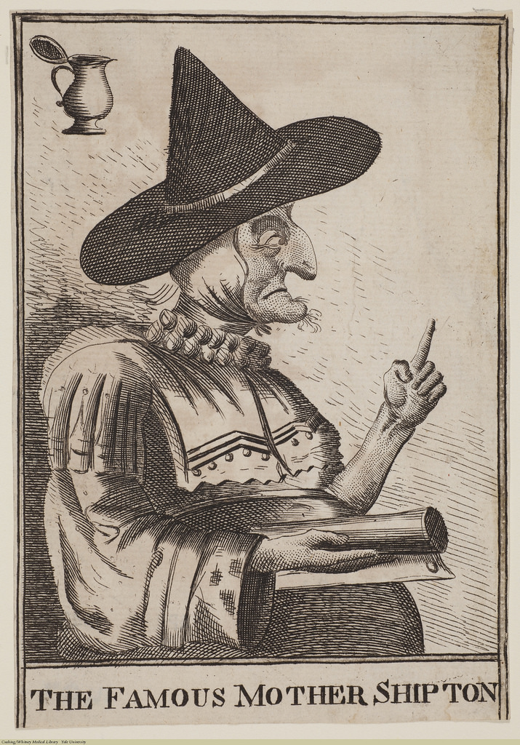
Witches
Beliefs About Witchcraft in 16th Century England
Created by: Jessica Wickstrom
University of Northern British Columbia
Notes:
The Famous Mother Shipton. Available on Brewminate. Published November, 2018. 715x1024. https://brewminate.com/divining-the-witch-of-york-propaganda-and-prophecy-mother-shipton-in-medieval-england/

Slide 2
What makes me seem like a witch?

Slide 3
Witches in History?
In the past, many countries around the world believed that there were real witches practicing magic amongst them.
Today we will focus on those accused of witchcraft in 16th century England.
Notes:
Cat-witch. Available on Catherine Austen: Books and Animals. Published April, 2014. 1600x1180. https://catherineausten.com/2014/02/03/whos-afraid-of-cats-fearless-february-day-3/

Slide 4
Who were they?
These witches were most often women, but sometimes men.
If a person was accused of witchcraft, they would be sent to jail until they could have trials where a judge would decide if they were guilty or not.
Notes:
A Man is Arraigned Before a Judge Scene Circa 1662. Available on Jon Kaneko-James: History, Fiction and Thoughts on Writing. Published October, 2016. 1024x852. https://jonkanekojames.com/tag/demons/

Slide 5
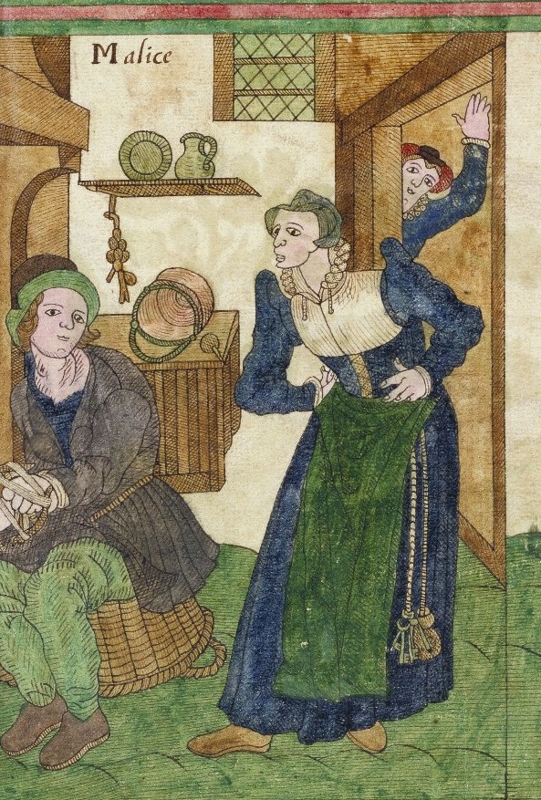
What often led to these witchcraft accusations?
-swearing/cursing
-having spots such as moles or birthmarks
-being a healer/wisewoman/wiseman
-being a widower
-stealing
-having enemies
-being rude
-speaking overly bluntly
-aggressive speech
-mumbling/murmuring
Notes:
A Peasant Woman Hectoring Her Husband. Trevilian Miscellaney, 1602. Available on Lizapalooza. Published October, 2013. 855x877. http://www.elizabethancostume.net/blog/clothing-the-elizabethan-poor/
Gasser, Erika. 2016. “Witchcraft, Possession, and the Unmaking of Women and Men: A Lat-Sixteenth-Century English Case Study.” Magic, Ritual, and Witchcraft 11 (2): 151-175.
Gibson, Marion. Early Modern Witches: Witchcraft Cases in Contemporary Writing. Florence: Taylor & Francis Group, 2001. Accessed May 15, 2020. ProQuest Ebook Central.

Slide 6
What are some things witches were accused of?
Causing illness
Turning children’s hands backwards
Witchcraft-possession
Having demonic familiars
Killing animals
Murder
Ruining crops
Working for the Devil
Making human-like figures out of wax/clay and pricking them with pins to cause pain for certain people
Notes:
Gasser, Erika. 2016. “Witchcraft, Possession, and the Unmaking of Women and Men: A Lat-Sixteenth-Century English Case Study.” Magic, Ritual, and Witchcraft 11 (2): 151-175.
Gibson, Marion. 2019. “Becoming-Witch: Narrating Witchcraft in Early Modern English News Pamphlets.” Magic, Ritual, and Witchcraft 14 (3): 317-335.
Gibson, Marion. Early Modern Witches: Witchcraft Cases in Contemporary Writing. Florence: Taylor & Francis Group, 2001. Accessed May 15, 2020. ProQuest Ebook Central.
Gibson, Marion. Reading Witchcraft: Stories of Early English Witches. London: Taylor & Francis Group, 1999. Accessed May 15, 2020. ProQuest Ebook Central.
“Witches’ Demonic Familiars at Chelmsford, 1566.” in The Witchcraft Sourcebook, edited by Brian Levack, 243-249. New York: Routledge, 2015.

Slide 7
Witches’ Familiars
Witches’ familiars were demonic, animal-like creatures which were believed to help the witches conduct their magical and evil deeds.
These familiars came in many animal forms, and sometimes they could even transform into something different.
The familiars were most often said to feed on bread, milk, witch’s blood, and various other animals.
Notes:
A Woodcut Illustration From a Book Published in 1579 of a Witch Feeding Her Familiars with Blood. Published October, 2017. Available on Express: Home of the Daily and Sunday Express. 590x364. https://www.express.co.uk/news/uk/873018/Witchcraft-gripped-Exeter-for-over-100-years-last-witch-executions
Gibson, Marion. Early Modern Witches: Witchcraft Cases in Contemporary Writing. Florence: Taylor & Francis Group, 2001. Accessed May 15, 2020. ProQuest Ebook Central.
“Witches’ Demonic Familiars at Chelmsford, 1566.” in The Witchcraft Sourcebook, edited by Brian Levack, 243-249. New York: Routledge, 2015.

Slide 8
How familiars were sometimes described…
-White spotted cats -Toads -Black dog, sometimes with horns -Gray Blackish Dove -Black frogs -Mole -Ferret with fiery eyes -White, shaggy dog -Rat -Black, grey, or white cat -white lamb -black or white tiny horse-like creatures
Notes:
A Woodcut Depiction of a Witch in 1643. Available on Wild Eyed Southern Celt. Published November, 2013. 572x400. https://wildeyedsoutherncelt.com/tag/17th-century-irish/
Gibson, Marion. Early Modern Witches: Witchcraft Cases in Contemporary Writing. Florence: Taylor & Francis Group, 2001. Accessed May 15, 2020. ProQuest Ebook Central.
“Witches’ Demonic Familiars at Chelmsford, 1566.” in The Witchcraft Sourcebook, edited by Brian Levack, 243-249. New York: Routledge, 2015.

Slide 9
What was witchcraft-possession?
Witchcraft possession was the belief that a witch could take control of another person’s body, sometimes they were believed to do this through their demonic familiars.

Slide 10
What did witchcraft-possession look like?
A strange kind of sickness
Swelling of the body
Violently scratching others
Intense sneezing
Trances
Violent shaking
The person being possessed often claimed to be visited by spirits who would speak into their ear
Bulging, staring eyes
Gnashing teeth
Foaming at the mouth
Vomiting various object such as hair, pins, nails, thread, feathers, lace
Roaring, hollow-sounding voice
Enormous strength
Bashing head or parts of the body
Notes:
Almond, Philip C. and ProQuest (Firm). 2004. Demonic Possession and Exorcism in Early Modern England: Contemporary Texts and their Cultural Contexts. ProQuest Ebook Central. Cambridge: Cambridge University Press, 2004. Accessed June 7, 2020. ProQuest Ebook Central.
Gasser, Erika. 2016. “Witchcraft, Possession, and the Unmaking of Women and Men: A Lat-Sixteenth-Century English Case Study.” Magic, Ritual, and Witchcraft 11 (2): 151-175.

Slide 11
Were witches, familiars, and possession real?
By analyzing historical texts we can assume that:
-Those accused of witchcraft were forced to confess and make lies about themselves and others. There are certain historical documents where the accused claim that they were forced to lie.
-Familiars were one of those lies.
-Those who claimed to be possessed were lying. There were certain incidences where the possessed claimed that they had made it all up. This could have been done for attention or for some other type of personal gain.
Notes:
Almond, Philip C. and ProQuest (Firm). 2004. Demonic Possession and Exorcism in Early Modern England: Contemporary Texts and their Cultural Contexts. ProQuest Ebook Central. Cambridge: Cambridge University Press, 2004. Accessed June 7, 2020. ProQuest Ebook Central.
“The Confessions of Johannes Junius at Bamberg, 1628.” in The Witchcraft Sourcebook, edited by Brian Levack, 214-218. New York: Routledge, 2015.

